Slide 1
CYBER 210 · NETWORK SECURITY
EchoVault
TLS TERMINATES
before the application
Protecting LLM prompt traffic beyond TLS
HPKE SHIFTS
where plaintext begins
Evaluating Browser to Server Application Layer Encryption.
TLS only
TLS + HPKE
prompt readable
{ seq, ct }
Aura Gaines · Cameron Faulkner · Fil Dziembowski
1
Notes:
Timing: 0:40–0:50.
Open with the project claim, not the implementation details: TLS can terminate before the intended application process, so plaintext may appear inside trusted infrastructure.
E2E LLM Prompt adds authenticated HPKE inside TLS to move the plaintext boundary to the intended echo-server process.
Preview the structure: brief problem and architecture, then the live comparison and red-team findings.
Speaker script:

Slide 2
TLS protects transport - not every infrastructure hop
Modern applications often terminate TLS at a proxy, gateway, WAF, load balancer, or CDN before traffic reaches the application process.
WHY THIS MATTERS
COMMON DEPLOYMENT
LLM prompts may carry personal data, credentials, internal business details, or other sensitive text.
Browser
→
TLS proxy
→
App
plaintext
RESEARCH QUESTION
TLS is working correctly, yet the intermediary can inspect the decrypted WebSocket frame.
How does browser-to-server application-layer encryption change what intermediaries can see compared with TLS alone?
This is where HPKE (Hybrid Public Key Encryption) RFC9180 comes into play
2
Notes:
Timing: 1:10–1:20.
Clarify the observer positions. A passive sniffer sees encrypted TLS records; TLS already addresses that case. A TLS-terminating proxy is different because it legitimately decrypts the connection.
The project focuses on the second observer: infrastructure that terminates or receives traffic after TLS termination but is not the process intended to read the prompt.
State the research question exactly, then transition to the design.
Speaker script:

Slide 3
EchoVault places an authenticated HPKE channel inside TLS
The proxy remains a TLS endpoint, but not an HPKE endpoint.
CODE DELIVERY CHANNEL
BROWSER
→
MITMPROXY
Can Inject JavaScript
→
Next.js Client
→
→
Receives the code that performs HPKE
Port 3000
OUTER CHANNEL · TLS 1.3 / wss://
CLIENT
DATA CHANNEL
TLS
BROWSER
→
MITMPROXY
→
Echo Server
→
→
seals before send
decrypts TLS · observes { seq, ct }
opens and echoes
AUTHENTICATED HPKE CHANNEL
CRYPTOGRAPHIC DESIGN
Identity
Confidentiality + integrity
Context binding
Failure policy
BIP-39 demo identity Ed25519 pin + signature
X25519 · HKDF-SHA-256 ChaCha20-Poly1305
session · direction · type · seq bound into associated data
reject + teardown fresh handshake required
3
Notes:
Timing: 1:25–1:40.
Walk left to right. The browser seals the prompt before the WebSocket frame crosses the TLS-terminating proxy. The FastAPI process holds the HPKE recipient private key and intentionally decrypts the prompt.
Define E2E precisely for this project: browser to intended echo-server process, not human-to-human messaging encryption.
Mention only the cryptographic details needed for Q&A: authenticated HPKE with X25519, HKDF-SHA-256, ChaCha20-Poly1305; the handshake uses a pinned Ed25519 identity; session, direction, frame type, and sequence are bound into associated data.
The failure policy tears down the link after authentication or ordering faults. This favors confidentiality and integrity over availability.
Add parallel channel- source code delivery channel
Speaker script:

Slide 4
The security claim is intentionally narrow
Protect prompt content from intermediaries after TLS termination—not from compromised endpoints.
IN SCOPE
HPKE DOES NOT ELIMINATE ENDPOINT TRUST.
Named observers and attacks
Plaintext still exists at trusted endpoints
• Passive network observer • TLS-terminating proxy, gateway, WAF, or load balancer • Key substitution and handshake tampering • Ciphertext tampering • Replay, reordering, and reflection • Malformed frames and accidental logging
• Intended server after HPKE decryption • Compromised browser or malicious extension • Modified frontend JavaScript or build pipeline • Root or administrative access to server memory • Stolen long-term keys and production key management • Metadata and denial-of-service protection
Scoped E2E definition: browser → intended echo-server process.
4
Notes:
Timing: 1:10–1:20.
Use this slide to prevent overclaiming before the demo. The project protects the data channel against a defined intermediary position and active frame manipulation.
It does not protect a malicious browser, compromised frontend code, the intended server after decryption, or privileged host access.
Call out code delivery as the most important residual risk: if the attacker controls the JavaScript that creates the ciphertext, they can read or copy the prompt before encryption.
Transition: the live demo tests exactly the in-scope boundary.
Speaker script:
Why doing this Goal is first step in confidential computing

Slide 5
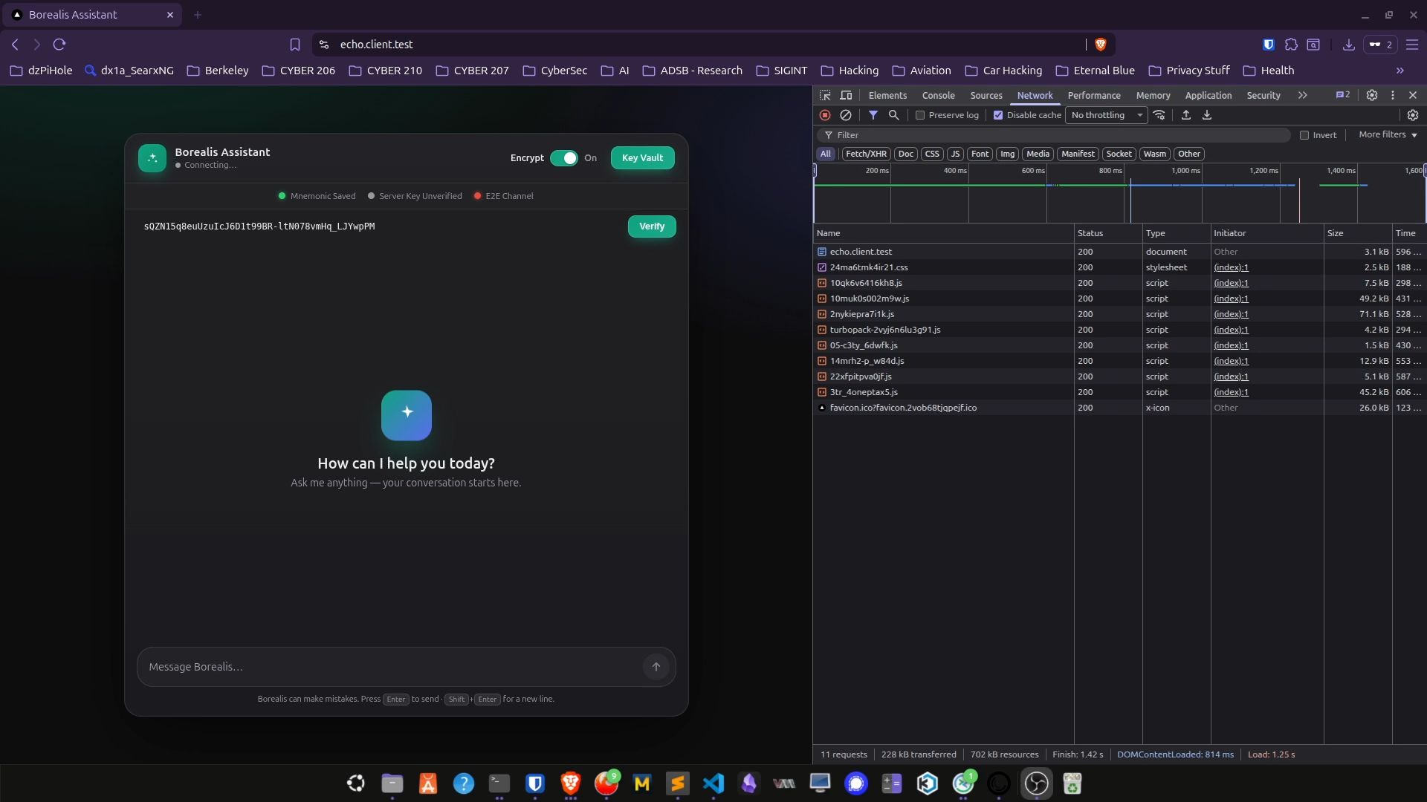
The live demo changes one variable: the E2E toggle
1 · BASELINE
Start all green
Pin verified Connected Encrypted session ready
TLS-only exposes the prompt at termination. HPKE hides the payload from that same intermediary. Active manipulation fails closed.
5
Notes:
Timing: 5:00–6:00. This is the centerpiece.
Before each test, confirm the browser baseline is fully healthy: pin verified, connected, and encrypted/all green. Use fake prompt data only.
Act 1 — baseline (about 30–45 seconds): show the browser state and identify the browser, mitmproxy, and FastAPI server views.
Speaker script:

Slide 6
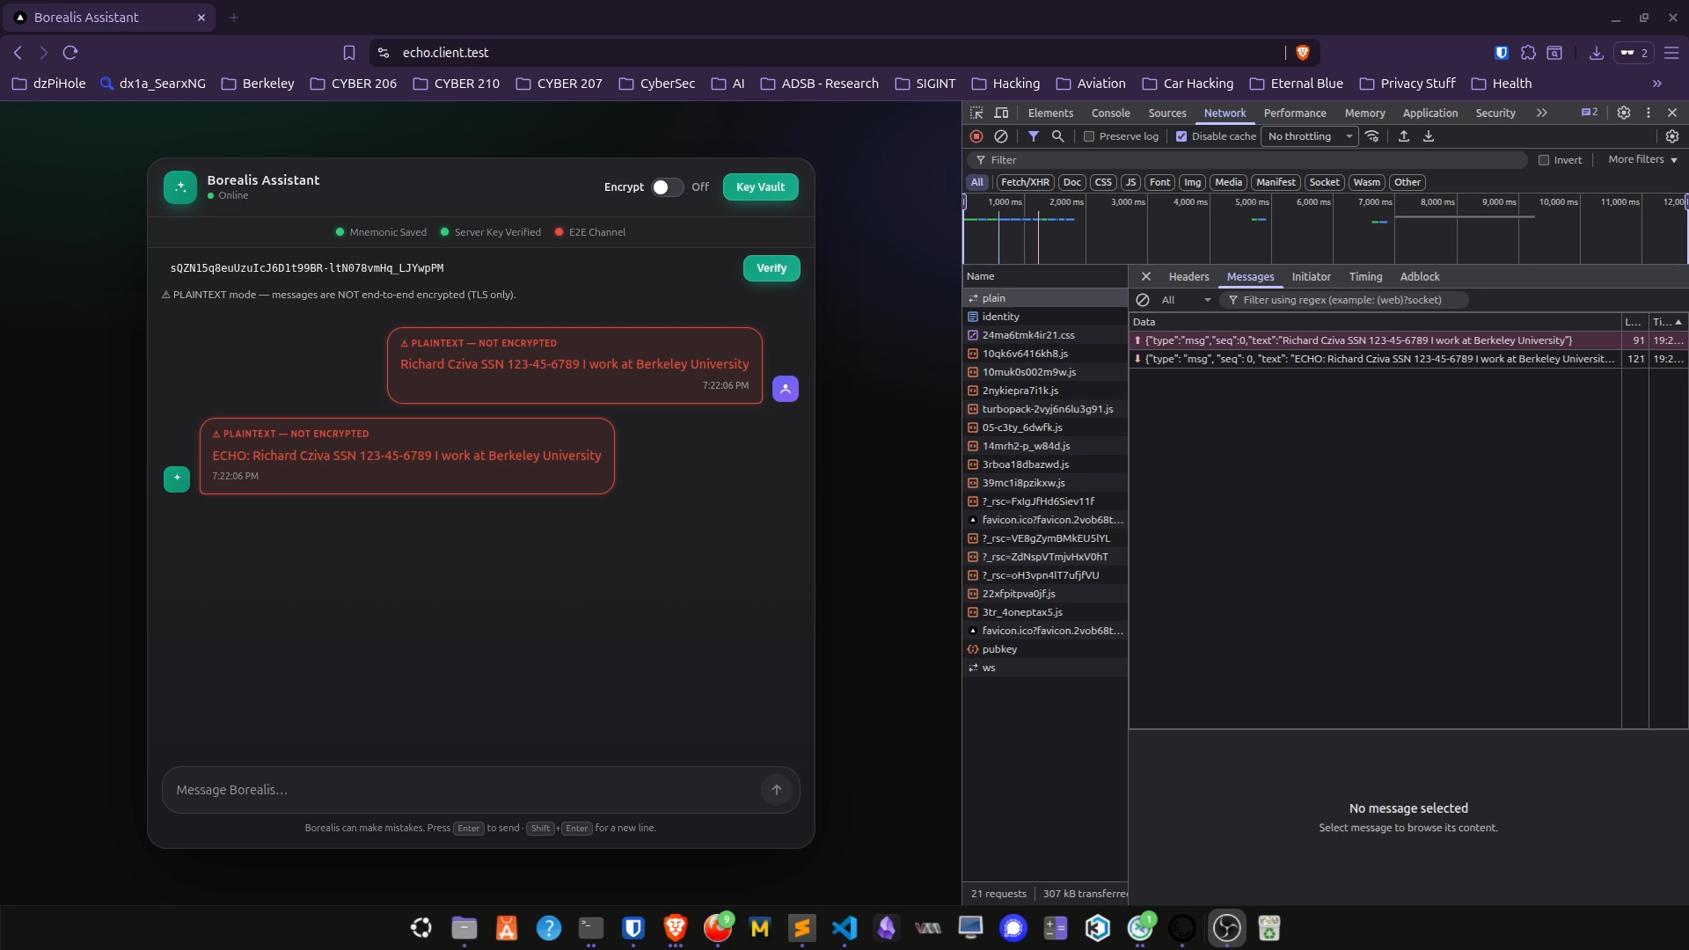
The live demo changes one variable: the E2E toggle
1 · BASELINE
Start all green
Pin verified Connected Encrypted session ready
TLS-only exposes the prompt at termination. HPKE hides the payload from that same intermediary. Active manipulation fails closed.
5
Notes:
Timing: 5:00–6:00. This is the centerpiece.
Before each test, confirm the browser baseline is fully healthy: pin verified, connected, and encrypted/all green. Use fake prompt data only.
Act 1 — baseline (about 30–45 seconds): show the browser state and identify the browser, mitmproxy, and FastAPI server views.
Speaker script:

Slide 7
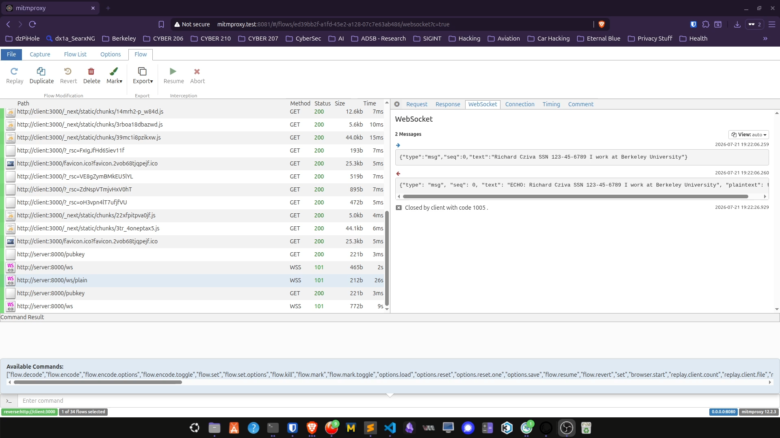
The live demo changes one variable: the E2E toggle
2 · VISIBILITY
Inspect the proxy
E2E OFF → prompt readable E2E ON → { seq, ct } only
7
Notes:
Timing: 5:00–6:00. This is the centerpiece.
Act 2 — Turn E2E ON, send a different unique prompt, and show seq and ct instead of the prompt. Return to the browser to prove the intended server still decrypts and echoes.
Speaker script:

Slide 8
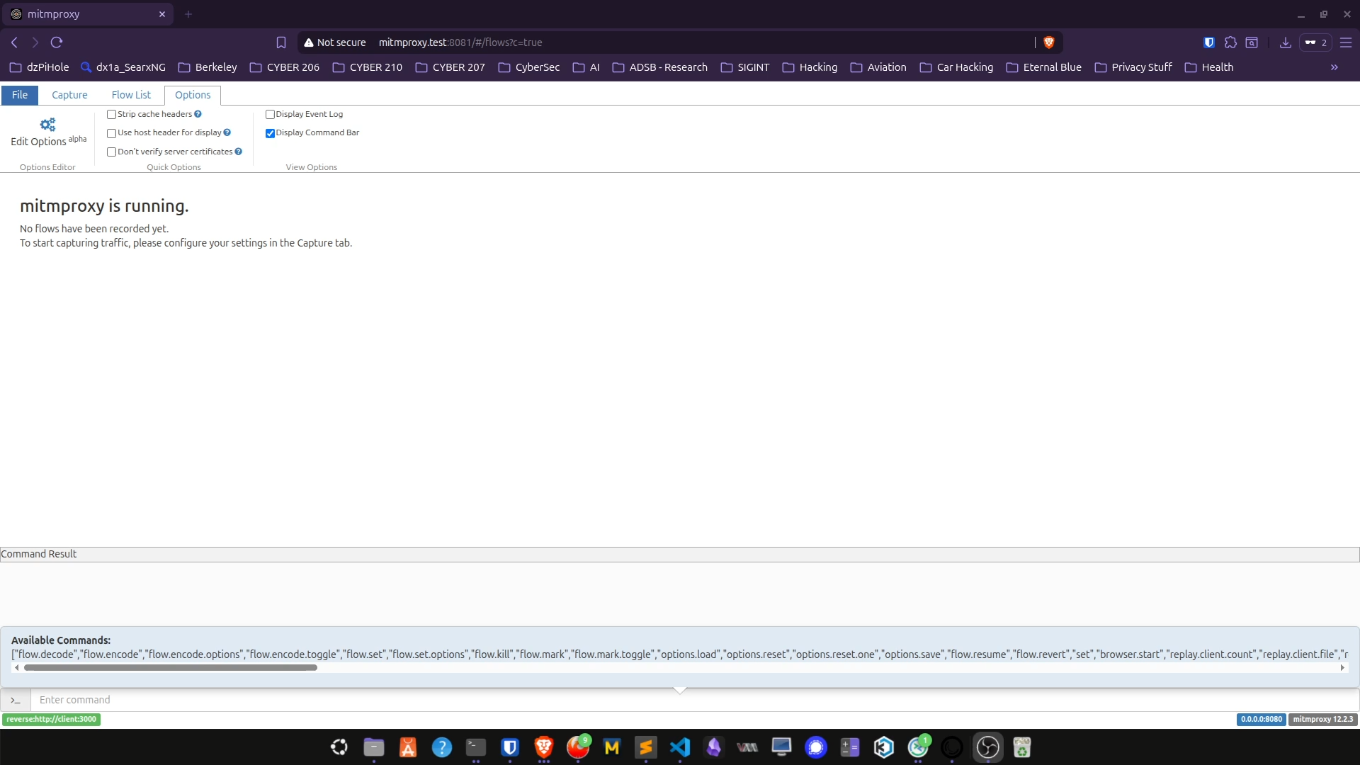
The live demo changes one variable: Code Delivery
1 · CODE INJECTION
Code Delivery Channel
Code injected by proxy and HPKE compromised
Source-code delivery" channel and the "data" channel must be protected— locally packaged/pinned— such as one built with Tauri or SRI, packaged extensions — can remove the code-delivery channel exploits.
8
Notes:
Timing: 5:00–6:00. This is the centerpiece.
Act 3 — integrity (about 1.5–2 minutes): tamper with or replay one encrypted frame. Show rejection or connection teardown and confirm there is no corrupted plaintext or duplicate echo.
Narrate the control: the observer position is unchanged; only application-layer encryption changes.
Fallback: keep the collected evidence screenshots open in advance. If the live path stalls, switch after 30 seconds and explain which expected observation each screenshot proves.
Speaker script:

Slide 9
Redteam testing supported the claim - and improved the implementation
The most valuable result was not merely passing attacks; it was finding where the original assumptions were too loose.
TEST AREA
OBSERVATION
SECURITY MEANING
Observer comparison
TLS-only showed plaintext; HPKE showed only seq + ciphertext.
Plaintext boundary moved past the TLS proxy.
Tamper + replay
Tampering, replay, ordering, and reflection were rejected.
No corrupted plaintext or duplicate echo; fail closed.
Identity + validation
Non-canonical pin and inconsistent malformed-input errors were found.
Canonical encoding, uniform rejection, and sanitized errors were added.
Leakage + metadata
Unique tokens were absent from searched logs; timing, size, and count remained visible.
Content confidentiality improved; traffic analysis remains possible.
9
Notes:
Timing: 1:30–1:45.
Do not read every cell. Lead with the first row as the direct answer to the research question, then use the identity and validation row to show how red-team work changed the implementation.
The non-canonical Base64URL pin representation was accepted even though the underlying key matched. The fix enforced canonical encoding rather than merely decoded-byte equality.
Malformed sequence and ciphertext paths originally produced inconsistent errors, including internal exception details. The implementation now rejects uniformly and sanitizes error output.
Leakage testing found no unique prompt tokens in the searched mitmproxy, client, server, or Docker logs, but metadata remained observable.
Speaker script:

Slide 10
EchoVault makes a hidden trust boundary visible
One toggle showed exactly where TLS stopped protecting prompt content - and where HPKE changed the result.
CONTROLLED COMPARISON
OBSERVABLE RESULT
SECURITY ENGINEERING
Same path. Different exposure.
Readable prompt became { seq, ct }
Attacks improved the design
The browser, proxy, server, and WebSocket route stayed constant; only HPKE changed.
The intended browser experience still worked while the TLS terminator lost content visibility.
Red testing verified fail-closed behavior..
WHY THIS MATTERS
Sensitive prompts can cross infrastructure that must route traffic securely.
E2E Enc Prompt turns that architectural concern into a concrete, repeatable test—and shows both the value and the limits of adding an inner encryption boundary.
TLS secures the connection. EchoVault controls where plaintext begins.
10
Notes:
Timing: 0:55–1:05.
This is the final assessment. The most interesting part of E2E LLM Prompt is that it makes an otherwise hidden trust boundary observable. We kept the browser, proxy, server, route, and prompt behavior constant; changing one encryption toggle changed what the intermediary could learn.
That makes the project more than a cryptographic implementation. It is a controlled security experiment: the proxy view answers the confidentiality question, the replay and tamper tests answer the integrity question, and the red-team fixes show how adversarial testing improved the implementation.
The direct answer to our research question is that browser-to-server application-layer encryption moved prompt plaintext beyond TLS termination without breaking the intended application behavior.
Keep the limitation honest: E2E LLM Prompt narrows the plaintext boundary; it does not remove endpoint trust, code-delivery risk, metadata leakage, or denial-of-service exposure.
End on the black-bar line: 'TLS secures the connection. E2E LLM Prompt controls where plaintext begins.' Pause before advancing.
Script:

Slide 11
CYBER 210 · NETWORK SECURITY
Thank you.
Any questions?
Protecting LLM prompt traffic beyond TLS
Aura Gaines · Cameron Faulkner · Fil Dziembowski
11
Notes:
Timing: 0:10, then Q&A.
Say: 'Thank you. We welcome your questions.' Then pause and leave this slide displayed.
Possible questions to prep for:
Q&A — Why not TLS? TLS protects between TLS endpoints; an approved reverse proxy can be an endpoint and receive plaintext.
Q&A — Does HPKE replace TLS? No. TLS still provides transport security; HPKE adds an inner application-layer confidentiality boundary.
Q&A — Is this user-to-user E2E? No. The scoped endpoint is the intended server process.
Q&A — What remains visible? Connection data, timing, ciphertext size, message count, and service use.
Q&A — Biggest residual risk? Code delivery. Modified frontend JavaScript can capture a prompt before honest HPKE code seals it.
Q&A — Forward secrecy? The demo does not protect past messages after compromise of the long-term recipient key; rotation or a ratchet is future work.
Script:

